Slide 1
Developing ChatBot 1-1 Introduction to Web App
Refresh-Foods Inc.
Yestin Yehoon Lee
Notes:
Hola,
Yo soy Yestin.
Este curso será en inglés, (This course will be in English,)
por qué puedo hablar español poco. (because I can speak spanish little.)
¿Está bien? (Is it OK?)
I work for Refresh Foods, as a software engineer.
From today, I will tech you how to …
Has anyone majored in computer science here?
or, has anyone ever developed a web application using JavaScript or other languages?
In this course, I will not teach you the computer language,
I want you to know the concept of web application,
and what is happening in the Internet.
Moreover, I want you to be interested in IT, by creating a handy program by yourselves.

Slide 2



What is happening on the Internet?
Internet
Internet & Web
Web browser(Client) & Server
web
Request
Web pages
Respond
Client
Web server
Notes:
The Internet is like
https://opentutorials.org/course/1688/9334
https://opentutorials.org/course/1688/9408

Slide 3
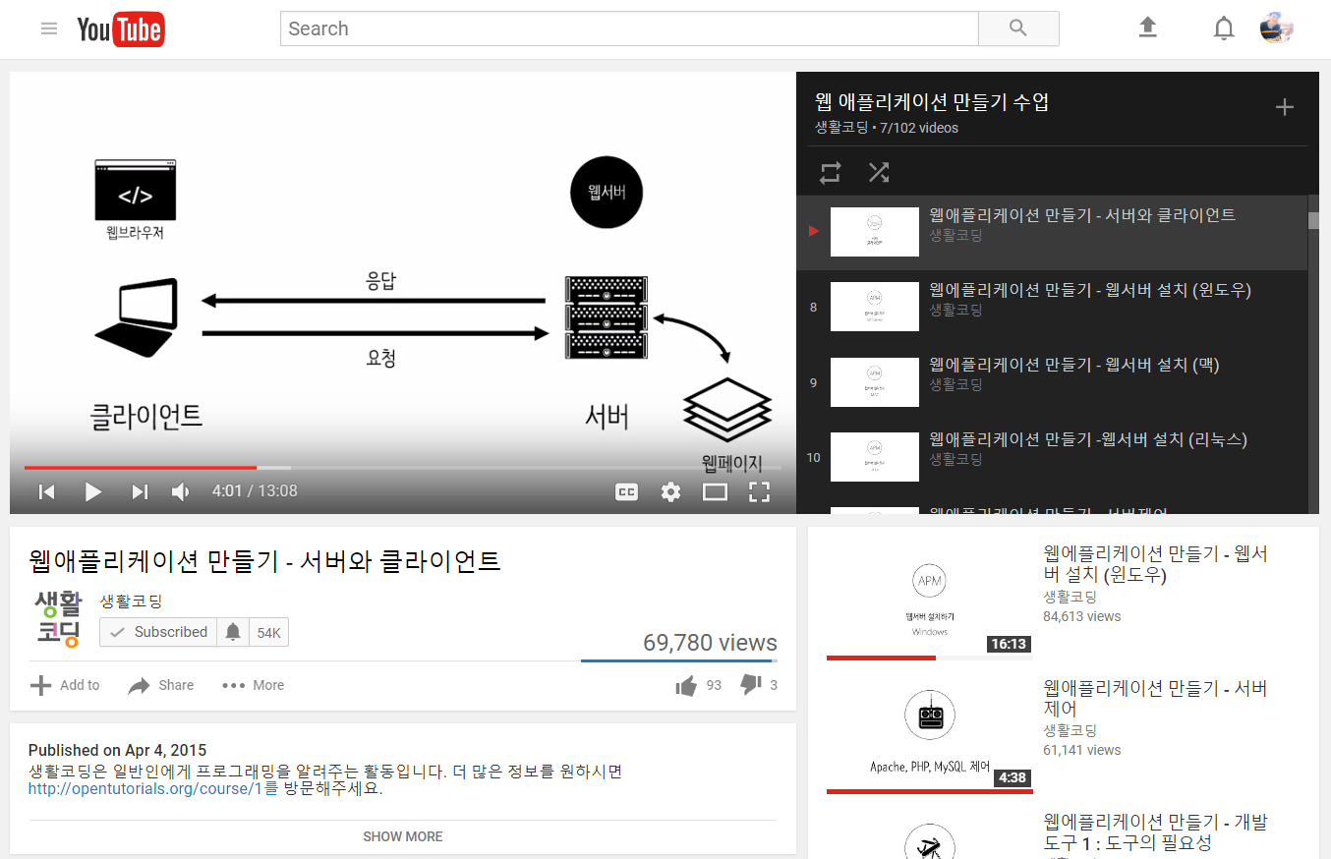
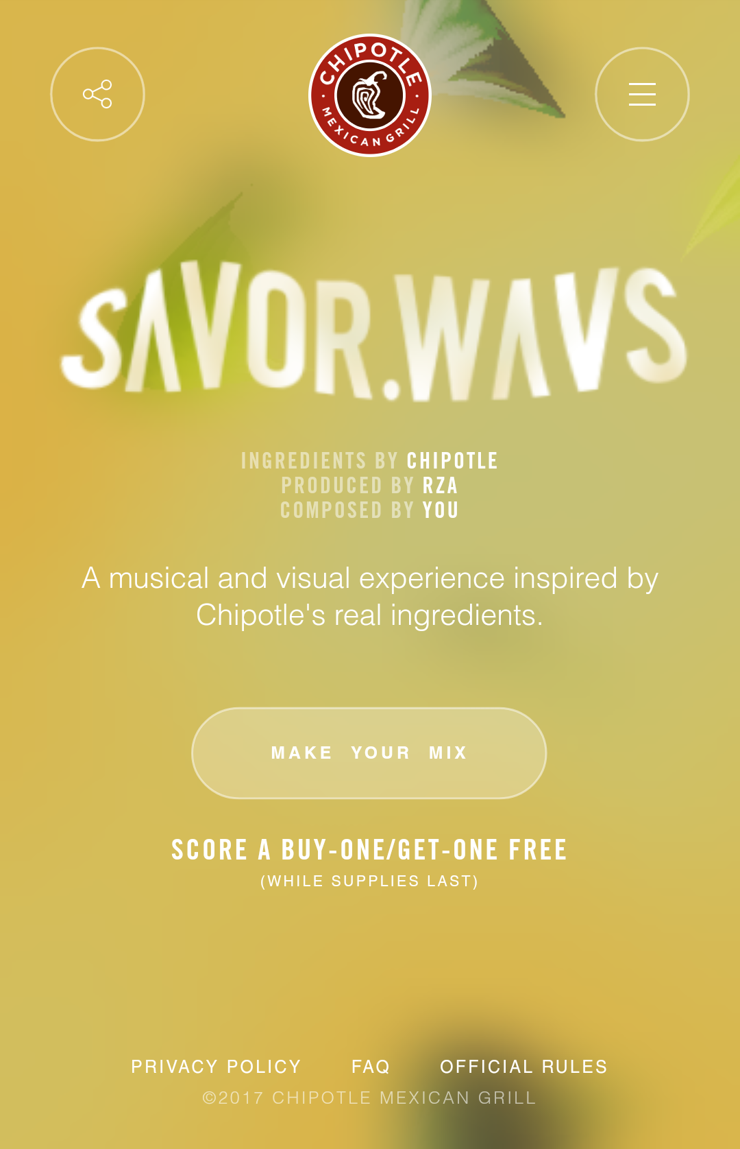
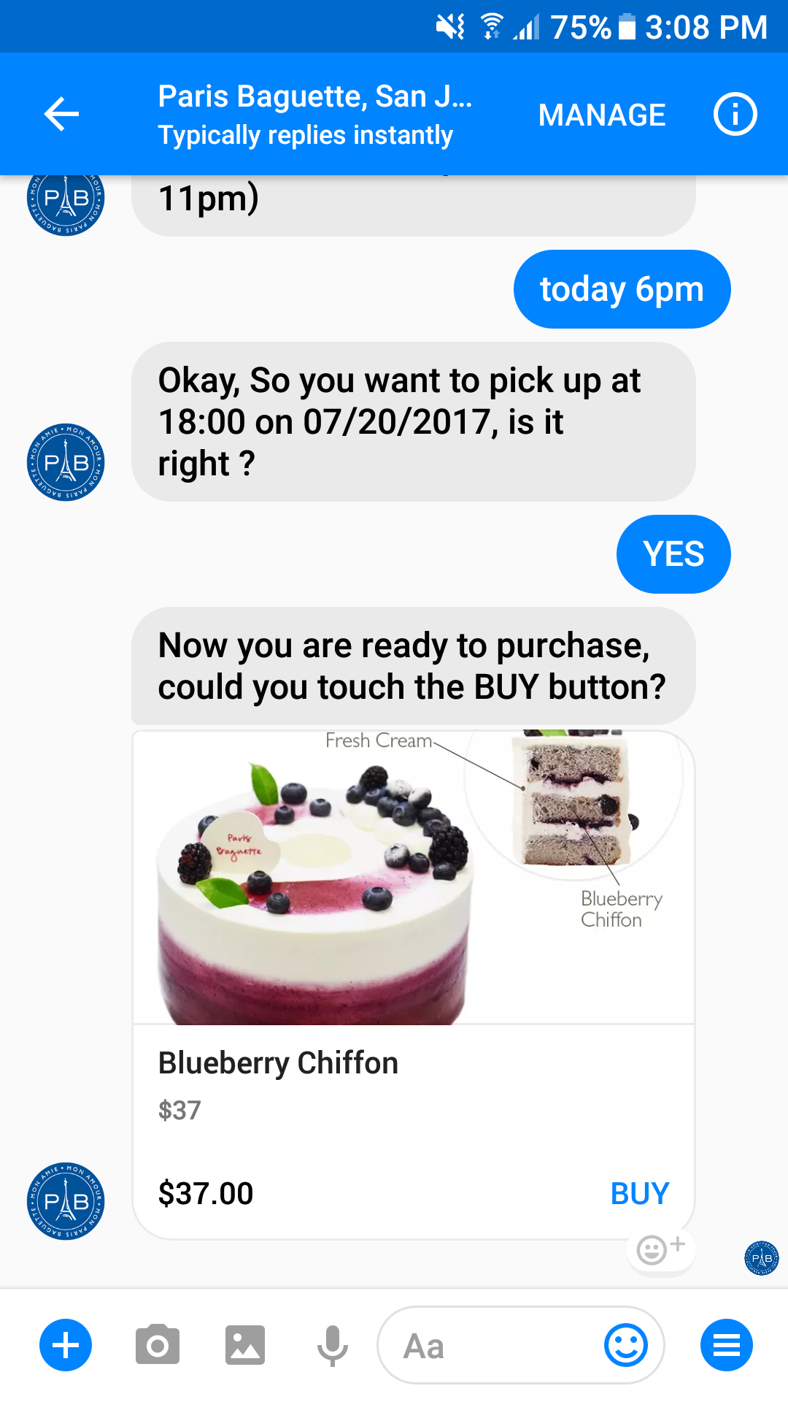
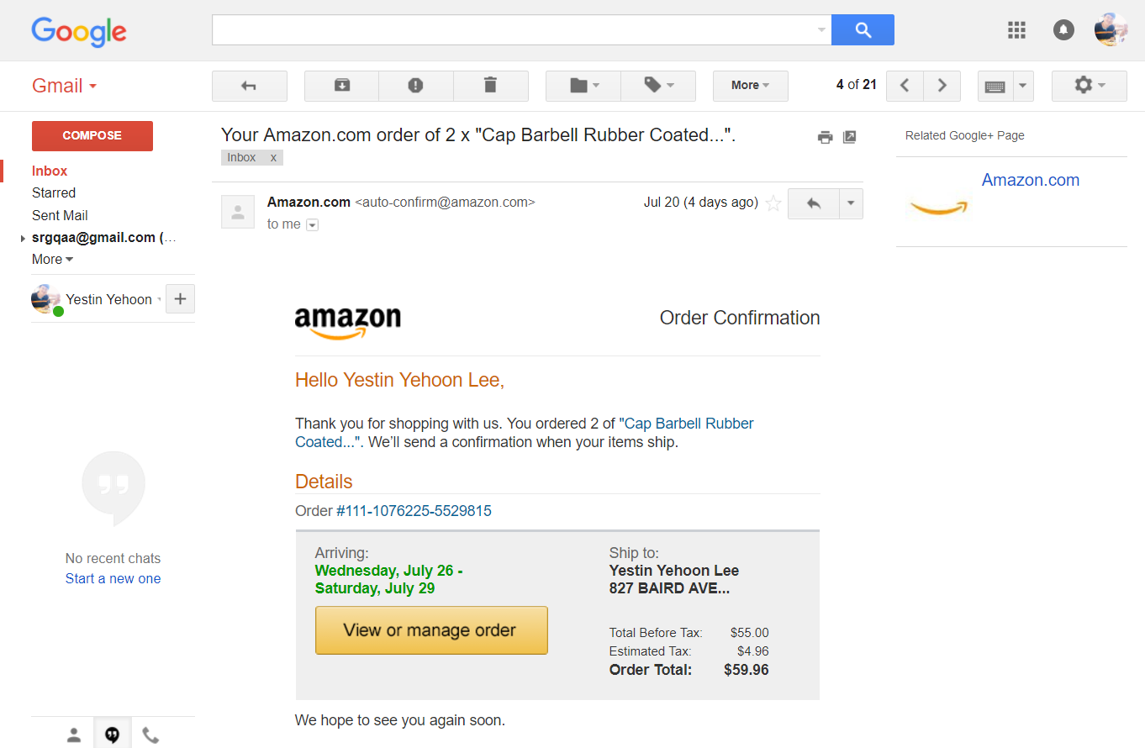
What is Web App?
Program running on the Web
Notes:
What is Web app?
Firstly, when you open the Internet
Imagine. Google home page, it looks quite simple.
However,
Think about Youtube, it has billions of videos, and it also has ads, playlists, live videos, and so on.
It is totally not a simple web site.
It seems something like programs are running on the web browser.
We call them Web application.

Slide 4
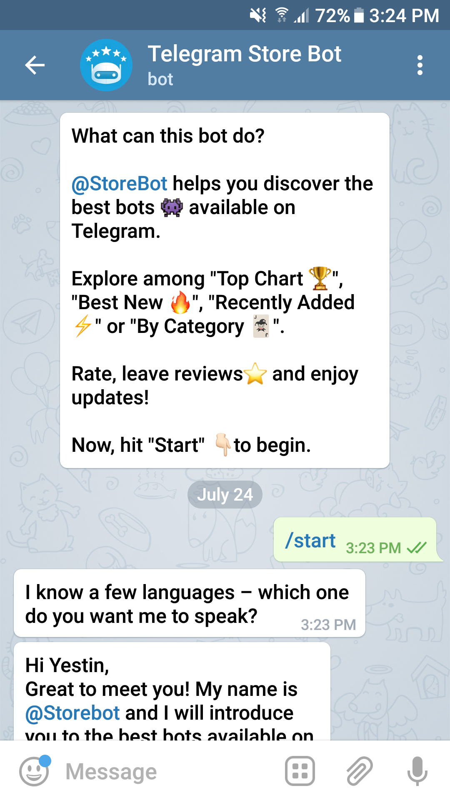
What is ChatBot?
A computer program
Often integrated into the dialog systems
Some of them process natural language
Behave as a conversational partner
Telegram Bot
Notes:
About ChatBot
I will tell you how to
ChatBot is also a kind of web application.

Slide 5
ChatBot – Pabby Demonstration
m.me/pbsanjose

